Slide 1
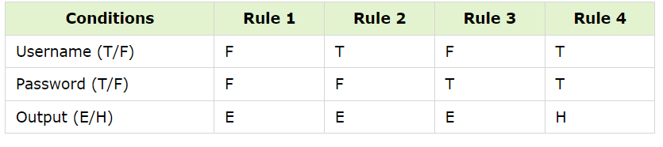
A Decision Table is a table that shows the relationship between inputs and rules, cases, and test complicated conditions. It's a very useful tool for both software testing and requirements management.
This is a methodical methodology in which the various input combinations and the accompanying system behavior (Output) are tabulated.
Example: How to Create a Login Screen Decision Base Table
The condition is simple − The user will be routed to the homepage if they give the right username and password. An error warning will appear if any of the inputs are incorrect.

Slide 2
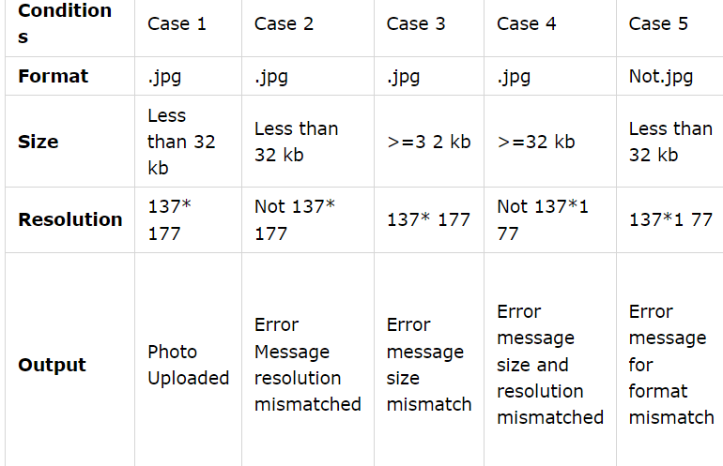
Example 2 − How to Make an Upload Screen Decision Table
You can only upload images in the '.jpg' format.
a file with a size of fewer than 32 kilobytes
137*177 pixels is the resolution.

Slide 3
Decision Table Testing's Benefits
When the system behavior varies depending on the input and is not consistent over a range of inputs, neither equivalent partitioning nor boundary value analysis can help, but a decision table can.
The representation is basic enough to be simply understood and may be utilized for both development and business.
This table will aid in the creation of successful combinations and can improve testing coverage.
Any complicated business situation may readily be transformed into a decision table.
This strategy can provide coverage when we are aiming for 100 percent coverage, which is usually the case when the number of input choices is modest.

Slide 4
Decision Table Testing's Drawbacks
The biggest drawback is that as the number of inputs grows, the table becomes more complicated.

Slide 5
Structured English
Structure English is derived from structured programming language which gives more understandable and precise description of process.
It is best used when sequences and loops in a program must be considered and the problem needs sequences of actions with decisions.
It does not have strict syntax rule. It expresses all logic in terms of sequential decision structures and iterations.

Slide 6
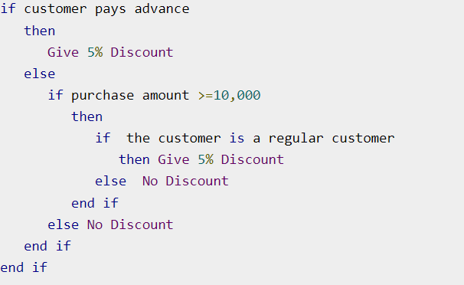

Slide 7
Pseudocode
A pseudocode does not conform to any programming language and expresses logic in plain English.
It may specify the physical programming logic without actual coding during and after the physical design.
It is used in conjunction with structured programming.
It replaces the flowcharts of a program.

